Slide 1
Topic: A Visualization Tool for Code-to-Test Traceability

Slide 2
Introduction
Code coverage is one of the testing activities which helps to understand how much of your source code is tested.
JavaCodeCoverage(JaCoCo) is one of the tool which is used in the direction of test-to-code. JaCoCo will show how your codebase is executed by your tests. It provides metrics such as line coverage, branch coverage, and method coverage, allowing you to identify which parts of your code are tested and which are not.
But a visualization in the other way i.e code-to-test should be developed. This will be the main goal and focus of our thesis.

Slide 3
Methodology
Development of such visualization tool revolves around EZUnit framework which link any programming issues to unsuccessful unit tests and our use case (https://gitlab.rz.uni-bamberg.de/swt/teaching/2022-ss/swt-swp-b/aracom-snacks/)
The objective of the tool is to show impact analysis of how code changes(from use case) in development package (src/main/java) affect the Test package (src/test/java).
Both development and test package have multiple java files.

Slide 4
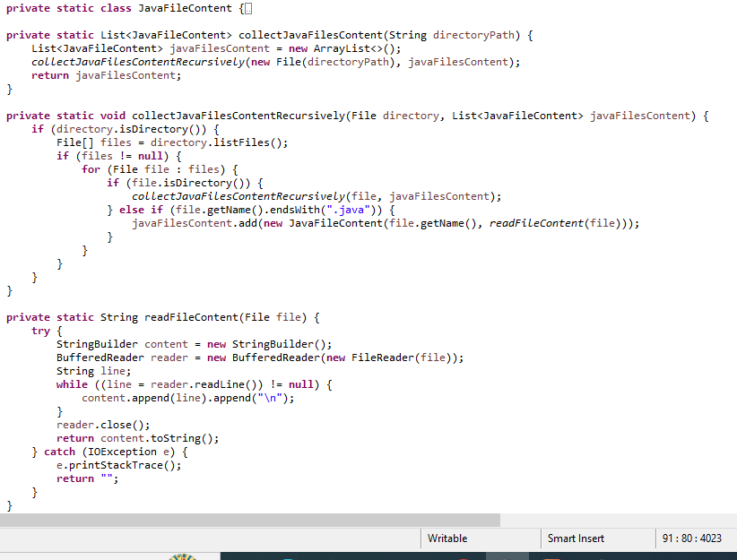
Tool Demonstration
Step 1: Collect the .java files from development package (src/main/java).
Step 2: Implement a parser to analyze the Java source code files. A common choice for parsing Java source code is using libraries like JavaParser.

Slide 5
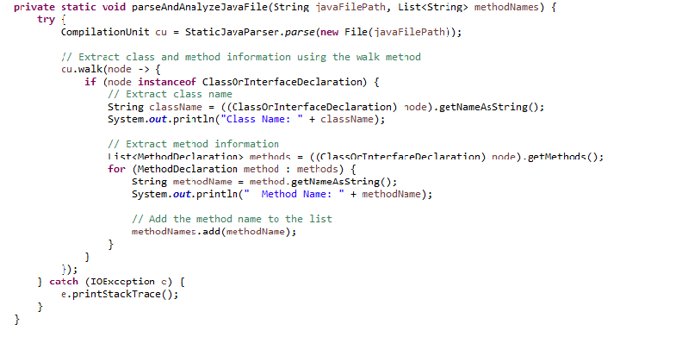
Step 3: Parse each Java file to extract information about classes and methods. For each class, gather its name and methods. For each method, get its name and any relevant information you need.
Step4: Similar to step 1, collect all .java files from the Test package (src/test/java)

Slide 6
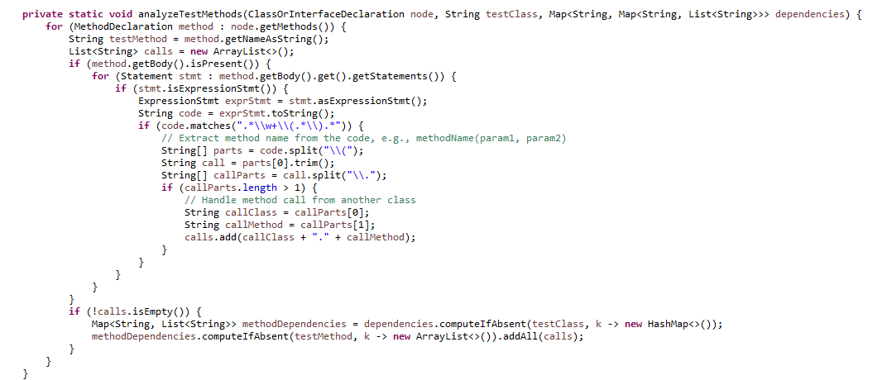
Step 5: For each test file, analyze its content to determine the methods it's dependent on. This will involve identifying method calls and determining which methods are being called from which classes.

Slide 7
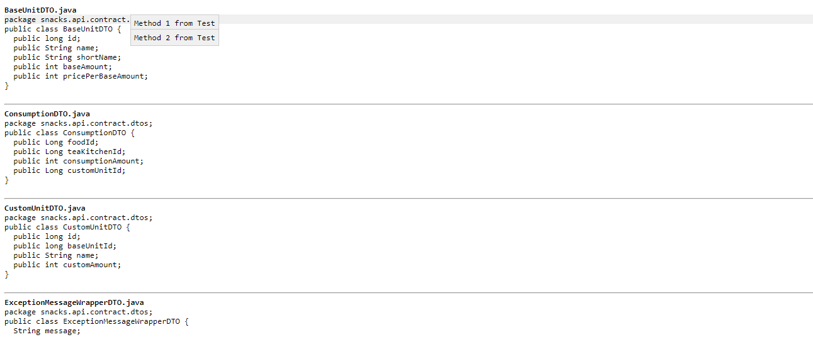
Result
Result will display all the .java files from development package and when user hovers through each line a tool tip will display all the test methods from test package its dependent on.

Slide 8
Conclusion
The tool facilitates impact analysis by examining how changes to variables, statements, and methods in the development package might affect the test package. By identifying and highlighting these dependencies, developers can assess the potential impact of modifications in one class on another, aiding in informed decision-making during the development process.

